Slide 1

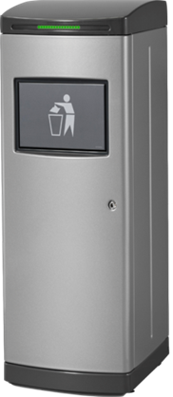
TOM 1040 Waste compactor
Brought to you by

Slide 2
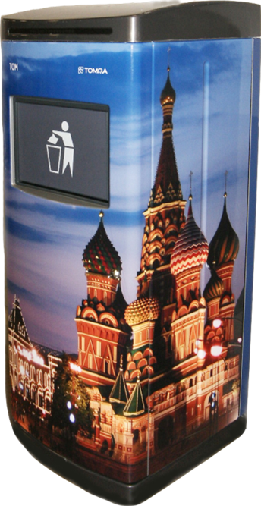
Meet TOM
TOM – the smart waste compactor for public spaces
Contributes to a clean, orderly and inviting environment.
Enhances productivity: More productive use of time for the staff!
Liberates valuable storage space.
Creates a friendlier and less labor-intensive and
time-consuming procedure for dealing with trash.
Communicates fullness level and readiness.
Provides a hygienic method of waste disposal and recycling
Designed to be wrapped with custom graphics and designs

Slide 3
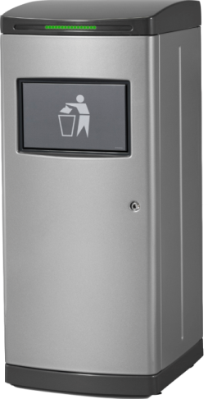
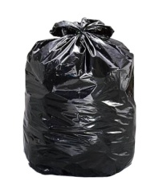
Meet TOM
TOM – the smart waste compactor for public spaces
Is about the same size as a conventional waste bin but can hold up to 7 times more waste!
Perfect for areas with high foot traffic
TOM saves time, space and money + keeps the environment at the customer site tidy and hygienic!

Slide 4
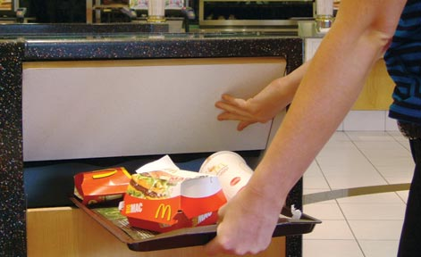
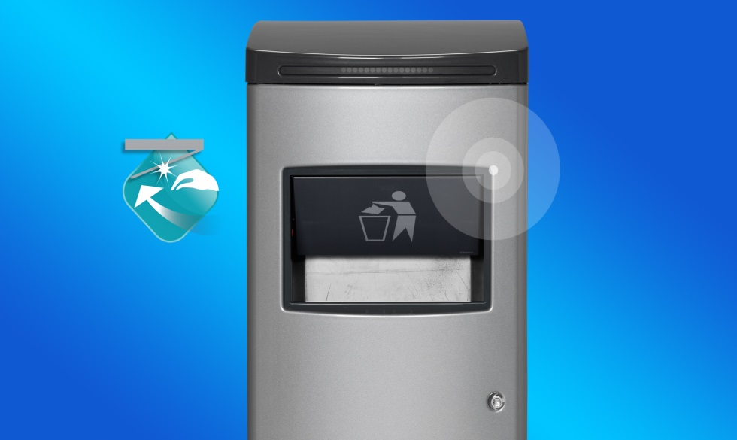
TOM´s intuition
The motion-sensor gets activated when someone is approaching and TOM opens the shutter automatically. The sensor range is adaptable to the conditions in your environment.

Slide 5
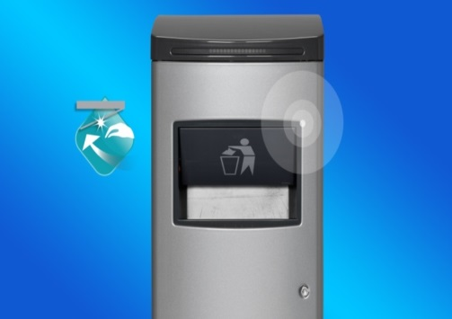
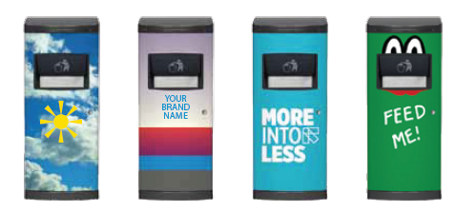
TOM’s many exciting Features
Automatic shutter: Radar senses people approaching – touch free operation!
Tom can hold up to 7X more than a conventional trash bin before the bag is full.
TOM has an easy to read status indicator bar, and staff can be alerted when TOM is full!
Tom works on standard single-phase power and is easy to install, operate, and maintain.
TOM is quiet, operating at just 51 dB or less.
Thanks to a built-in sensor, TOM can tell when there is a low traffic period (30 minutes or more without anyone approaching). During that time, TOM compresses the trash and keeps it compacted.
Beautiful design: gray silvery finish as standard surface.

Slide 6

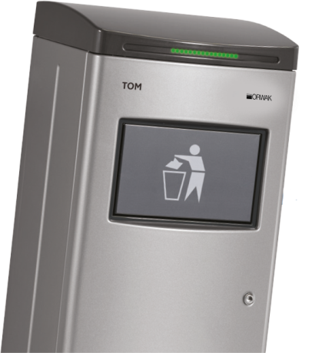
Configure TOM for Your Needs:
TOM Connect – a modem-based communication module, so TOM can communicate via e-mails to staff!
TOM options: the tray holder, the bag trolley, the transparency kit, either front or rear door bin access, liquid module, casters.
Eye-catching cool wrappings - company logo or brand information designed to make TOM fit in or to stand out!

Slide 7
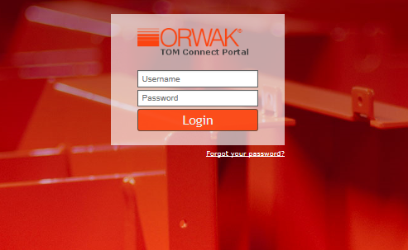
tom connect feature’s
“TOM Connect” provides information on the status of your fleet of activated TOM units!
TOM sends two types of notifications: ”Full (bag)” and Fault”.
A stable Internet connection is necessary in the environment where TOM is installed for Connect to work properly.
TOM Connect gives you access to a web portal 24/7

Slide 8
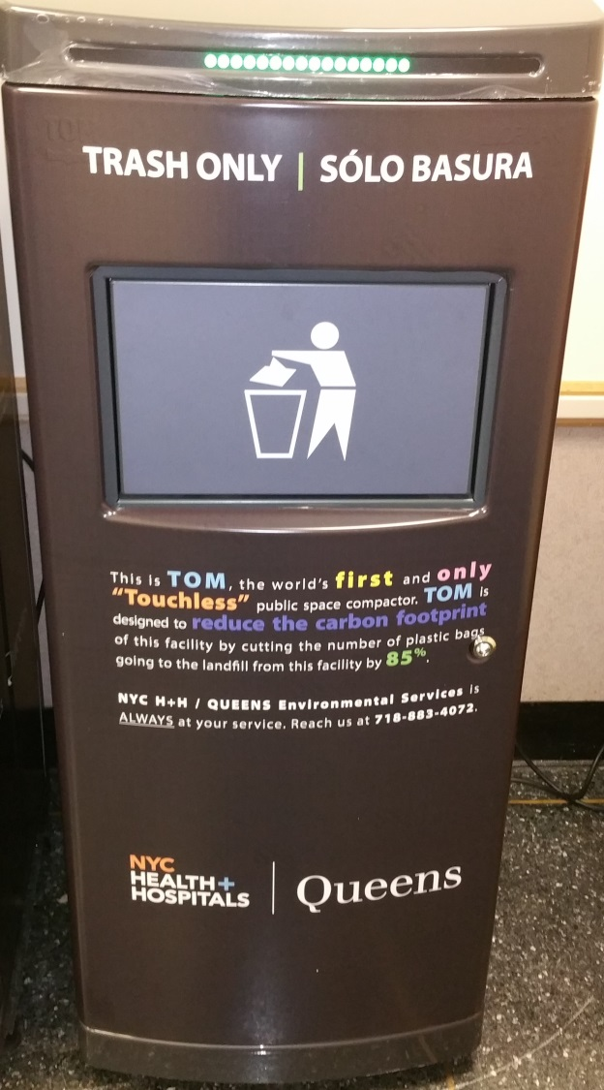
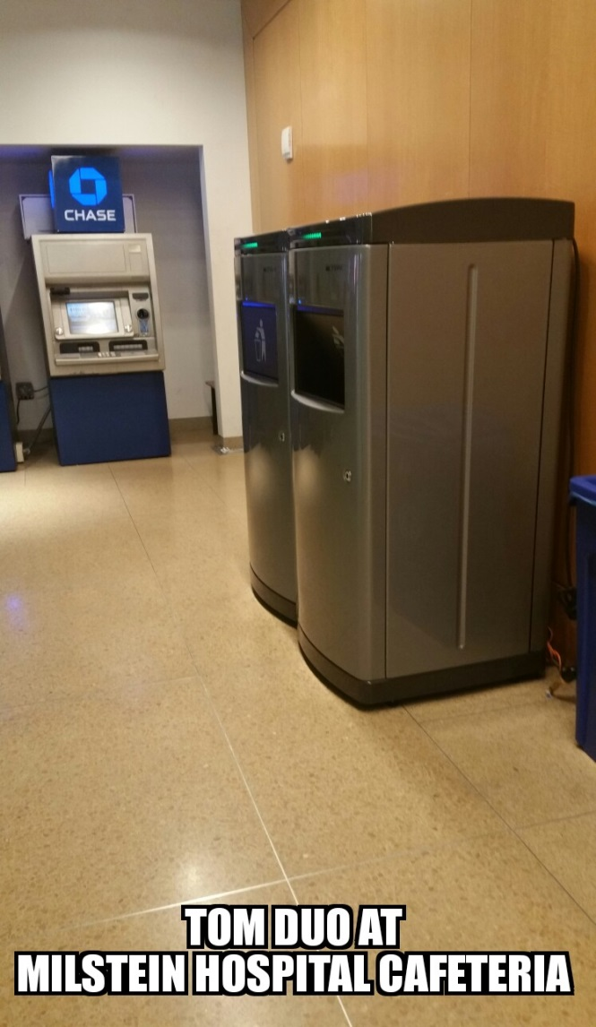
Tom FOR HOSPITALS

Slide 9
TOM Benefits
LABOR COST SAVINGS– less time spent on waste handling and more time dedicated to the maintenance of other areas of importance within the facilities.
MATERIAL COST SAVINGS– Because TOM holds significantly more trash, fewer trash bags will be needed and fewer bags will be sent to the landfill.
SPACE SAVINGS– Fewer TOMs are needed, so additional space is freed up in cafeterias and other common areas.
TRASH DISPOSAL SAVINGS– TOM’s compacted waste can result in fewer trash pick-ups which results in a reduction in pulls by the carting company.
MORE HYGIENIC DISPOSAL OPERATION– Tom’s hands-free operation will be appreciated by customers and helps mitigate transference of pathogens.
INCREASE SUSTAINABILITY – Less trash volume = less transportation = reduced CO₂ emission.
A CLEANER ENVIRONMENT– Improved curb appeal. No more overflowing waste receptacles.

Slide 10
Tom Success stories
Brought to you by

Slide 11

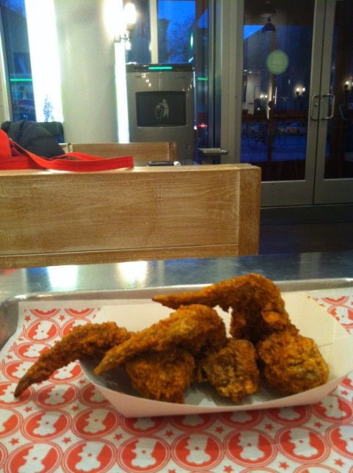
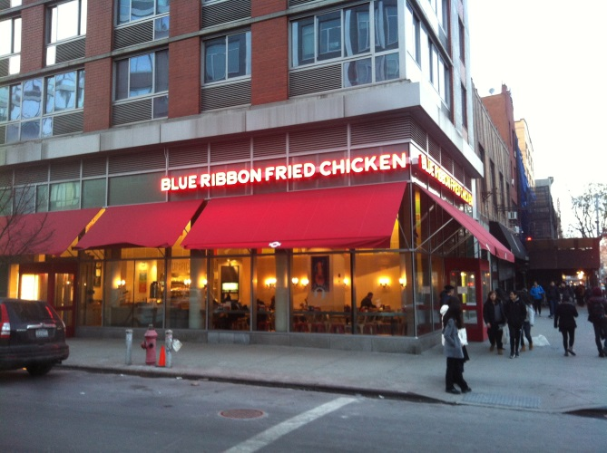
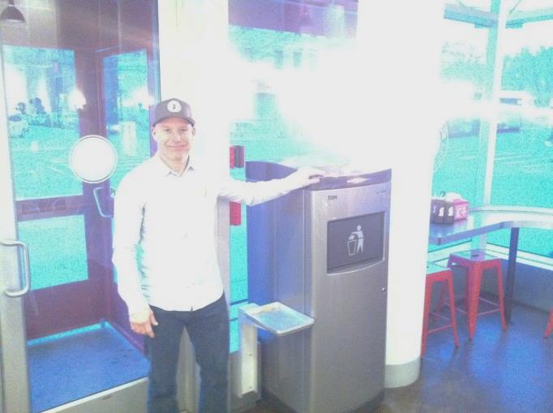
Case study – blue ribbon fried Chicken, NYC
Popular fast food restaurant in Manhattan; serves 400-500 guests daily.
Two TOM units installed result in only 1-2 bag switches per day.
TOM benefits: time-saving, less staff needed during the late night shift, reduced waste handling costs and a cleaner, neater environment in the restaurant!

Slide 12
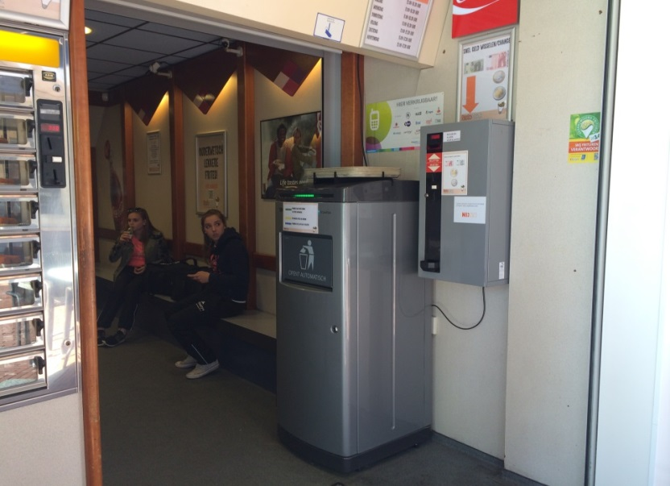
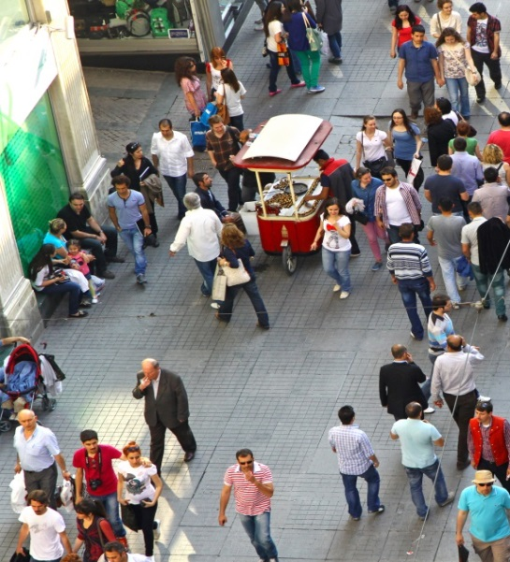

Case study – restoquick, NL
A small cafeteria located on the busy main street in Eindhoven City Center in the Netherlands.
Savings from day one with TOM installed! One bag switch per day with TOM instead of 6-7 bag switches with traditional waste bins.
No waste storage on location; 10 minutes walkway to and from a container a block away.
TOM benefits: time saving and a waste handling cost reduction of $€$1200 per year due to smaller container size and less frequent waste collections.

Slide 13
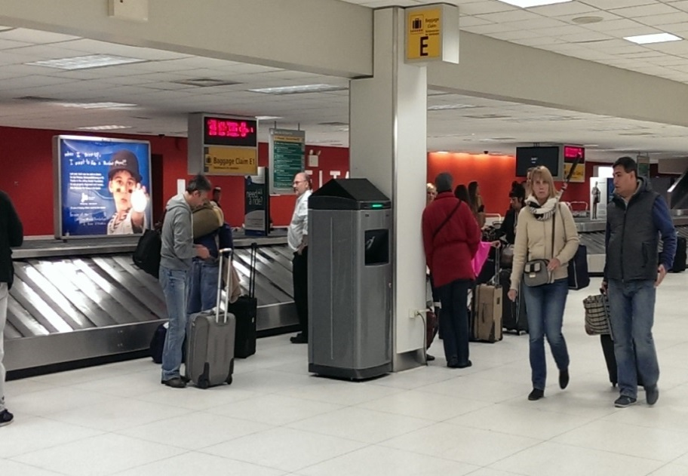
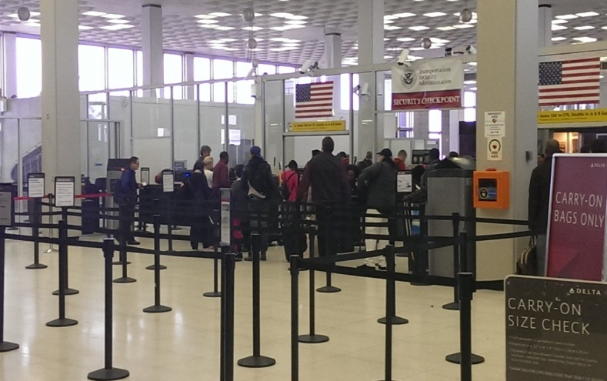
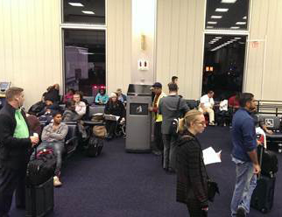
Case study – new york airports
UNOFFICIAL REFERENCE
In total 80 TOM units at the airports JFK, La Guardia and Newark
Located at security, at the baggage claim and in the lounges.
Operated by a facility management company
TOM benefits: resource saving for the facility manager; much less frequent bag switches and check ups on the machines, positive hygienic effect thanks to touch-free shutter

Slide 14
Contact Franklin Cruz, Exclusive Distributor
Direct Environmental Corp.
(A Certified Minority Business Enterprise)
1231 Lafayette Avenue – 2nd Floor
Bronx, NY 10474
Tel: 1-718-607-7658
Fax: 1-718-504-7873
Web: www.decgreen.com

